Slide 1
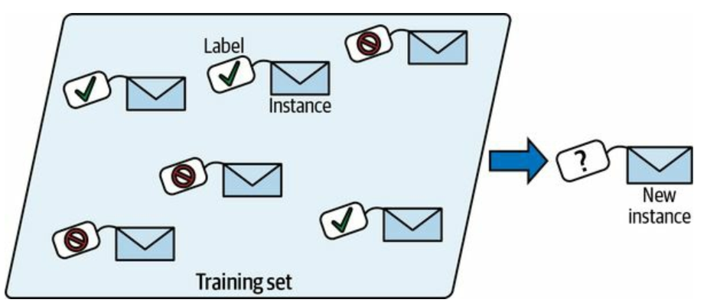
Supervised Learning: Classification
Classification in machine learning is a type of supervised learning where the goal is to categorize or classify data points into predefined classes or labels.
Given input data (features), a classification algorithm learns a mapping function that assigns a label (or class) to each data point based on the training data. It is used when the output variable is categorical, meaning it falls into one of several distinct categories.
Examples of Classification Algorithms:
Logistic Regression
K-Nearest Neighbors (KNN)
Decision Trees
Naive Bayes
Support Vector Machine (SVM)
Random Forest
Neural Networks

Slide 2
Classification : KNN
K-Nearest Neighbors (KNN)
It is a simple, non-parametric, instance-based machine learning algorithm. It can be also used as regression tasks.
KNN works by finding the "k" closest data points (neighbors) to a new, unknown data point and making predictions based on their classes.
KNN does not build a model during the training phase. Instead, it stores the training data and makes predictions by referencing it directly during testing. This is why it is also called a lazy learner.
Advantages of KNN:
KNN is easy to understand and implement. Since KNN doesn’t build a model, the training phase is fast. It can be used for both classification and regression problems. KNN doesn’t make assumptions about the underlying data distribution (Non-parametric).

Slide 3
Classification : KNN
How KNN Works:
Select k Neighbors: The parameter "k" refers to the number of nearest neighbors to consider when making a prediction.
Calculate Distance: The algorithm calculates the distance between the new data point and all other points in the training dataset. Common distance metrics include: Euclidean Distance, Manhattan Distance.
Identify Nearest Neighbors: After calculating the distances, the algorithm selects the k nearest points (neighbors) from the training set.
Make a Prediction: Classification: The new point is assigned to the class that is most common among its k nearest neighbors (majority voting).

Slide 4
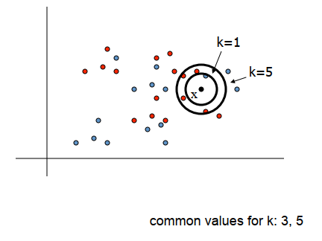
Classification : KNN
How KNN Works:
To classify a new input vector x, examine the k‐closest training data points to x and assign the object to the most frequently occurring class.

Slide 5
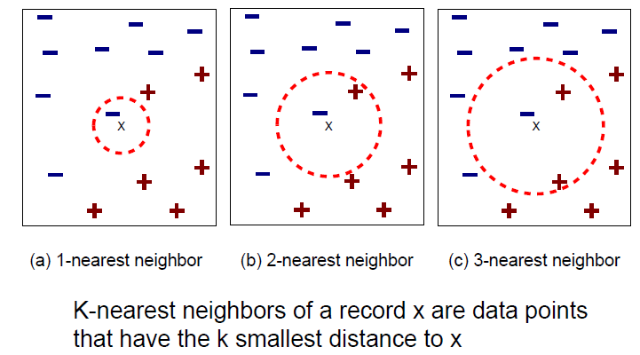
Classification : KNN
How KNN Works:

Slide 6
Classification : KNN
Example of KNN:
Height (cm) | Weight (KG) | Class
167 | 51 | Underweight
182 | 62 | Normal
176 | 69 | Normal
173 | 64 | Normal
172 | 65 | Normal
174 | 56 | Underweight
169 | 58 | Normal
173 | 57 | Normal
170 | 55 | Normal
170 | 57 | ?

Slide 7

Classification : KNN
Example of KNN:
$$d=\sqrt{{\left(x_{2}−x_{1}\right)}^{2}+{\left(y_{2}−y_{1}\right)}^{2}}$$
$$d_{1}=\sqrt{{\left(170−167\right)}^{2}+{\left(57−51\right)}^{2}}$$
$$d_{2}=\sqrt{{\left(170−182\right)}^{2}+{\left(57−62\right)}^{2}}$$
.
.
.
$$d_{9}=\sqrt{{\left(170−170\right)}^{2}+{\left(57−55\right)}^{2}}$$
Height (cm) | Weight (KG) | Class
167 | 51 | Underweight
182 | 62 | Normal
176 | 69 | Normal
173 | 64 | Normal
172 | 65 | Normal
174 | 56 | Underweight
169 | 58 | Normal
173 | 57 | Normal
170 | 55 | Normal
170 | 57 | ?

Slide 8
Classification : KNN
Example of KNN:
Height (cm) | Weight (KG) | Class | d
167 | 51 | Underweight | 6.7
182 | 62 | Normal | 13
176 | 69 | Normal | 13.4
173 | 64 | Normal | 7.6
172 | 65 | Normal | 8.2
174 | 56 | Underweight | 4.1
169 | 58 | Normal | 1.4
173 | 57 | Normal | 3
170 | 55 | Normal | 2
170 | 57 | ?

Slide 9
Classification : KNN
Example of KNN:
Height (cm) | Weight (KG) | Class | d | Rank
169 | 58 | Normal | 1.4 | 1
170 | 55 | Normal | 2 | 2
173 | 57 | Normal | 3 | 3
174 | 56 | Underweight | 4.1 | 4
167 | 51 | Underweight | 6.7 | 5
173 | 64 | Normal | 7.6 | 6
172 | 65 | Normal | 8.2 | 7
182 | 62 | Normal | 13 | 8
176 | 69 | Normal | 13.4 | 9
170 | 57 | ?

Slide 10
Classification : KNN
Example of KNN:
Height (cm) | Weight (KG) | Class | d | Rank
169 | 58 | Normal | 1.4 | 1
170 | 55 | Normal | 2 | 2
173 | 57 | Normal | 3 | 3
174 | 56 | Underweight | 4.1 | 4
167 | 51 | Underweight | 6.7 | 5
173 | 64 | Normal | 7.6 | 6
172 | 65 | Normal | 8.2 | 7
182 | 62 | Normal | 13 | 8
176 | 69 | Normal | 13.4 | 9
170 | 57 | ?
K=3

Slide 11
Classification : KNN
Example of KNN:
Height (cm) | Weight (KG) | Class | d | Rank
169 | 58 | Normal | 1.4 | 1
170 | 55 | Normal | 2 | 2
173 | 57 | Normal | 3 | 3
174 | 56 | Underweight | 4.1 | 4
167 | 51 | Underweight | 6.7 | 5
173 | 64 | Normal | 7.6 | 6
172 | 65 | Normal | 8.2 | 7
182 | 62 | Normal | 13 | 8
176 | 69 | Normal | 13.4 | 9
170 | 57 | ?
K=4

Slide 12
Classification : KNN
Example of KNN:
Height (cm) | Weight (KG) | Class | d | Rank
169 | 58 | Normal | 1.4 | 1
170 | 55 | Normal | 2 | 2
173 | 57 | Normal | 3 | 3
174 | 56 | Underweight | 4.1 | 4
167 | 51 | Underweight | 6.7 | 5
173 | 64 | Normal | 7.6 | 6
172 | 65 | Normal | 8.2 | 7
182 | 62 | Normal | 13 | 8
176 | 69 | Normal | 13.4 | 9
170 | 57 | ?
K=5

Slide 13
Classification : KNN
KNN Code:
https://colab.research.google.com/drive/1WvzjLHrb2Yf0ocPfUPUAIL7lYTIAvGwl?usp=sharing

Slide 14
Classification : KNN
Disadvantages of KNN:
Computationally Expensive: As the size of the dataset increases, the algorithm becomes slow because it has to calculate the distance for each test point with every training point.
Sensitive to Noisy Data: Outliers or irrelevant features can significantly affect predictions.
Feature Scaling Required: Since KNN relies on distance calculations, features must be scaled properly to prevent features with larger ranges from dominating the distance calculation.
Memory-Intensive: The algorithm needs to store the entire training dataset, making it less memory-efficient for large datasets.

Slide 15
Classification : Decision Tree
Decision Trees are a popular supervised machine learning algorithm used for both classification and regression tasks. They work by learning simple decision rules inferred from the data features to predict a target label.
A Decision Tree is structured as a tree where each node represents a decision based on a feature of the data, and each branch represents an outcome of that decision.
The root node is the topmost node, representing the first decision.
The internal nodes are decision points, splitting based on feature values.
Leaf nodes are the endpoints representing the final prediction or output.

Slide 16
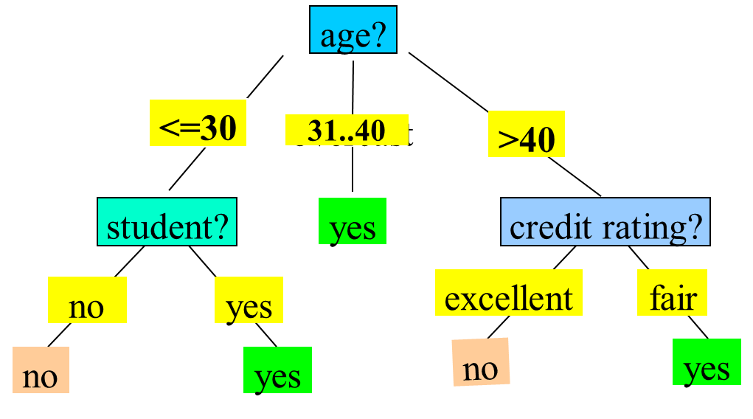
Classification : Decision Tree

Slide 17
Classification : Decision Tree
Basic algorithm (a greedy algorithm):
Tree is constructed in a top-down recursive divide-and-conquer manner
At start, all the training examples are at the root
Attributes are categorical (if continuous-valued, they are discretized in advance)
Examples are partitioned recursively based on selected attributes
Test attributes are selected based on a heuristic or statistical measure (e.g., information gain)

Slide 18
Classification : Decision Tree
ID3 (Iterative Dichotomiser 3) is a classic algorithm used to construct a Decision Tree, primarily for classification tasks. It was developed by Ross Quinlan and serves as one of the earliest algorithms in Decision Tree-based models.
D3 aims to create a Decision Tree by selecting the most significant feature at each step that best separates the data for classification.
It does this by using information gain (based on entropy) as the criterion to determine the best feature to split on.
Conditions for stopping partitioning:
All records have the same target class (pure leaf node).
No more features to split on (terminate as a leaf node).
Reaching a specified maximum depth or minimum samples threshold to prevent overfitting.

Slide 19
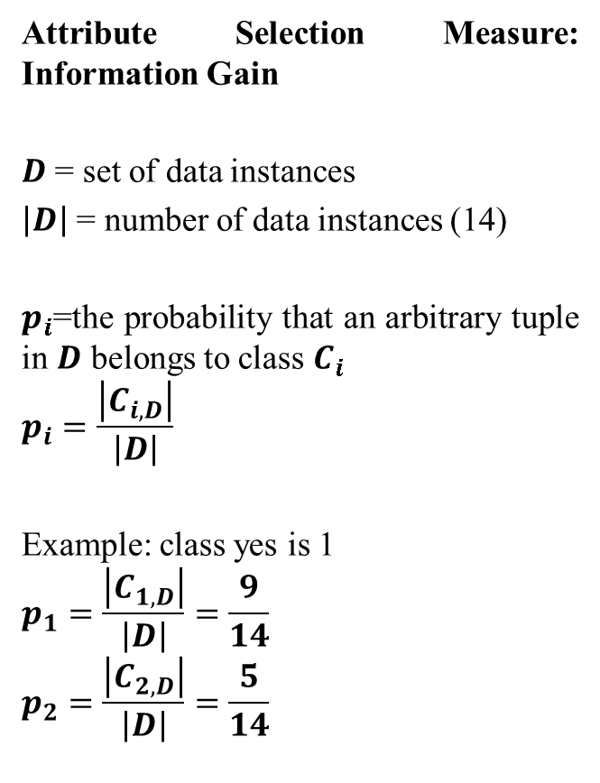
Classification : Decision Tree
Attribute Selection Measure: Information Gain
$D$ = set of data instances
$\left|D\right|$ = number of data instances (14)
$p_{i}$=the probability that an arbitrary tuple in $D$ belongs to class $C_{i}$
$$p_{i}=\frac{\left|C_{i,D}\right|}{\left|D\right|}$$
Example: class yes is 1
$$p_{1}=\frac{\left|C_{1,D}\right|}{\left|D\right|}=\frac{9}{14}$$
$$p_{2}=\frac{\left|C_{2,D}\right|}{\left|D\right|}=\frac{5}{14}$$

Slide 20
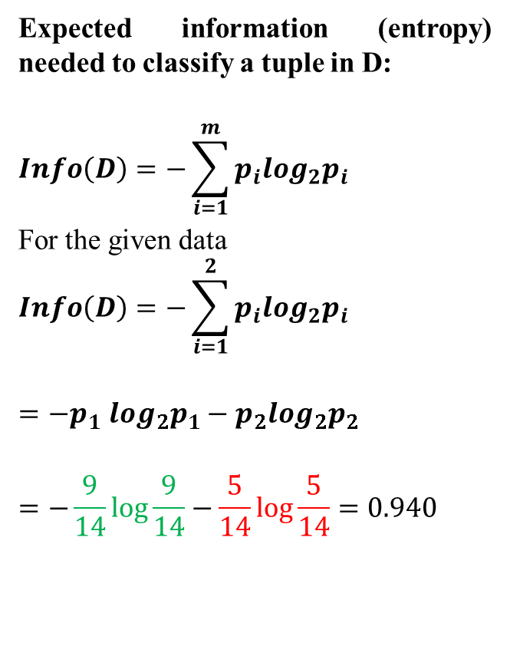
Classification : Decision Tree
Expected information (entropy) needed to classify a tuple in D:
$$Info\left(D\right)=−\sum_{i=1}^{m}{p_{i}\log_{2}p_{i}}$$
For the given data
$$Info\left(D\right)=−\sum_{i=1}^{2}{p_{i}\log_{2}p_{i}}$$
$${=−p}_{1}\log_{2}p_{1}−p_{2}\log_{2}p_{2}$$
$$=−\frac{9}{14}\log{\frac{9}{14}}−\frac{5}{14}\log{\frac{5}{14}}=0.940$$

Slide 21
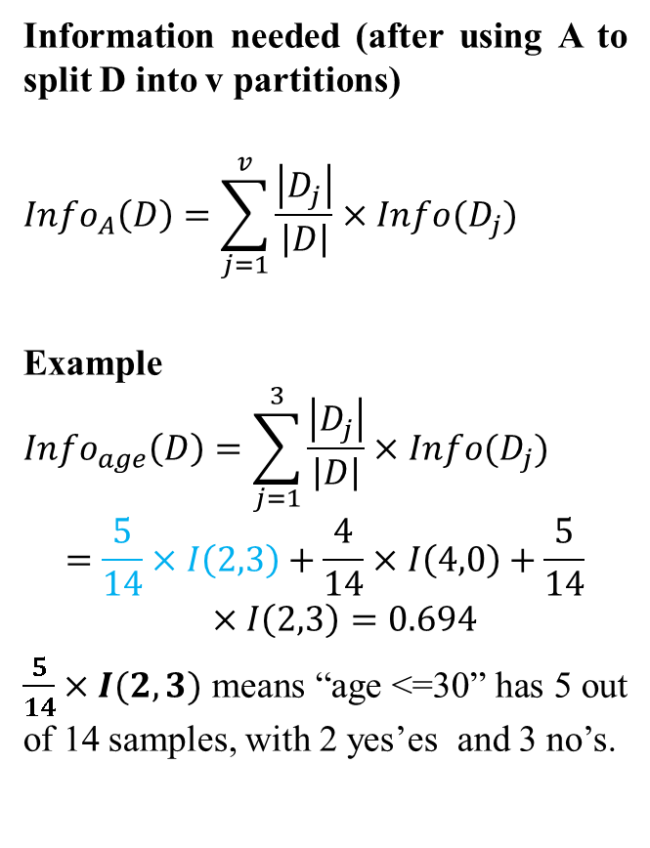
Classification : Decision Tree
Information needed (after using A to split D into v partitions)
$${Info}_{A}\left(D\right)=\sum_{j=1}^{v}{\frac{\left|D_{j}\right|}{\left|D\right|}}×Info(D_{j})$$
Example
$${Info}_{age}\left(D\right)=\sum_{j=1}^{3}{\frac{\left|D_{j}\right|}{\left|D\right|}}×Info(D_{j})$$
$$=\frac{5}{14}×I\left(2,3\right)+\frac{4}{14}×I\left(4,0\right)+\frac{5}{14}×I\left(2,3\right)=0.694$$
$\frac{5}{14}×I(2,3)$ means “age <=30” has 5 out of 14 samples, with 2 yes’es and 3 no’s.

Slide 22
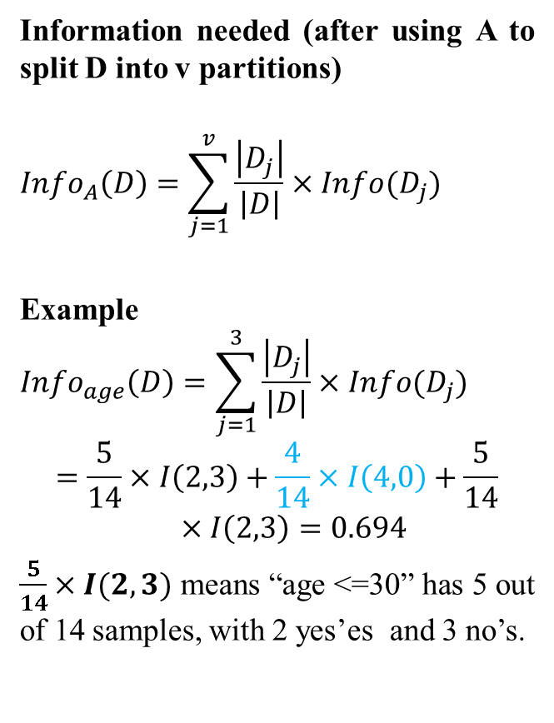
Classification : Decision Tree
Information needed (after using A to split D into v partitions)
$${Info}_{A}\left(D\right)=\sum_{j=1}^{v}{\frac{\left|D_{j}\right|}{\left|D\right|}}×Info(D_{j})$$
Example
$${Info}_{age}\left(D\right)=\sum_{j=1}^{3}{\frac{\left|D_{j}\right|}{\left|D\right|}}×Info(D_{j})$$
$$=\frac{5}{14}×I\left(2,3\right)+\frac{4}{14}×I\left(4,0\right)+\frac{5}{14}×I\left(2,3\right)=0.694$$
$\frac{5}{14}×I(2,3)$ means “age <=30” has 5 out of 14 samples, with 2 yes’es and 3 no’s.

Slide 23
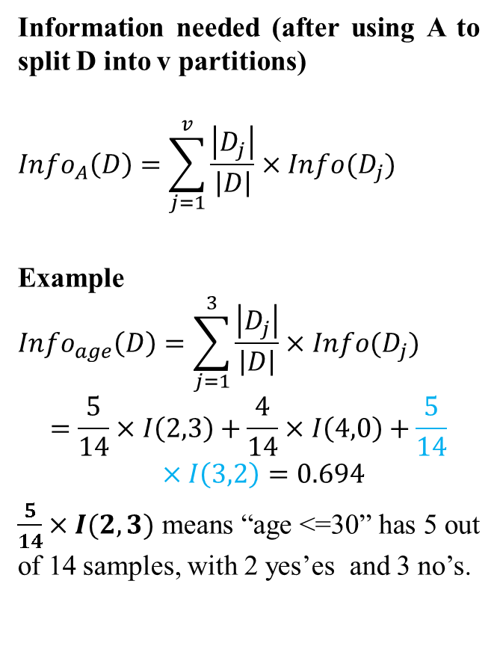
Classification : Decision Tree
Information needed (after using A to split D into v partitions)
$${Info}_{A}\left(D\right)=\sum_{j=1}^{v}{\frac{\left|D_{j}\right|}{\left|D\right|}}×Info(D_{j})$$
Example
$${Info}_{age}\left(D\right)=\sum_{j=1}^{3}{\frac{\left|D_{j}\right|}{\left|D\right|}}×Info(D_{j})$$
$$=\frac{5}{14}×I\left(2,3\right)+\frac{4}{14}×I\left(4,0\right)+\frac{5}{14}×I\left(3,2\right)=0.694$$
$\frac{5}{14}×I(2,3)$ means “age <=30” has 5 out of 14 samples, with 2 yes’es and 3 no’s.

Slide 24
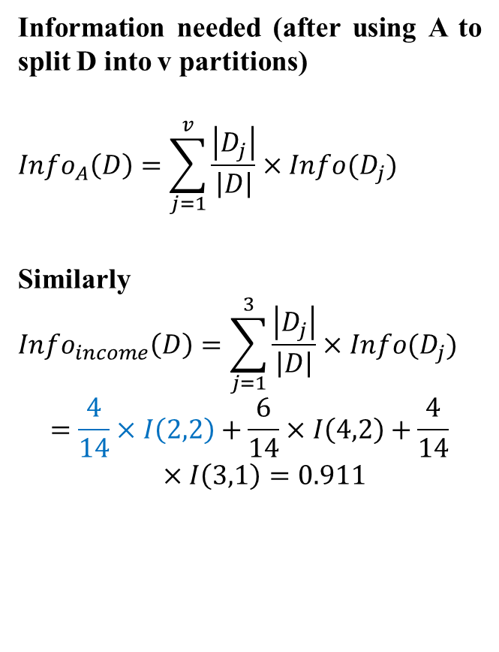
Classification : Decision Tree
Information needed (after using A to split D into v partitions)
$${Info}_{A}\left(D\right)=\sum_{j=1}^{v}{\frac{\left|D_{j}\right|}{\left|D\right|}}×Info(D_{j})$$
Similarly
$${Info}_{income}\left(D\right)=\sum_{j=1}^{3}{\frac{\left|D_{j}\right|}{\left|D\right|}}×Info(D_{j})$$
$$=\frac{4}{14}×I\left(2,2\right)+\frac{6}{14}×I\left(4,2\right)+\frac{4}{14}×I\left(3,1\right)=0.911$$

Slide 25
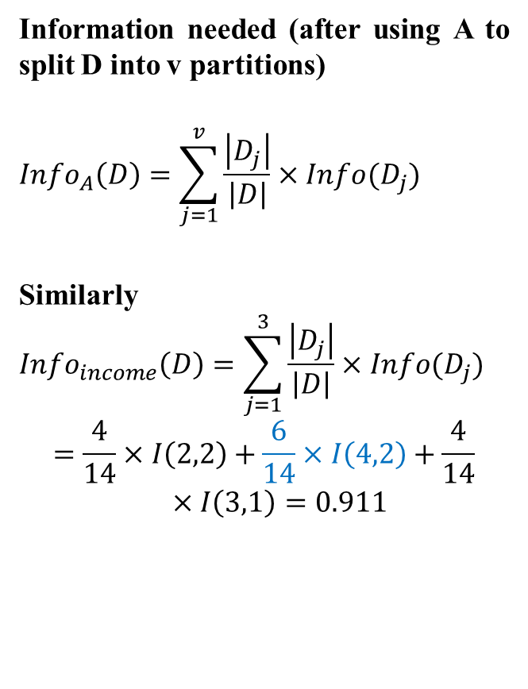
Classification : Decision Tree
Information needed (after using A to split D into v partitions)
$${Info}_{A}\left(D\right)=\sum_{j=1}^{v}{\frac{\left|D_{j}\right|}{\left|D\right|}}×Info(D_{j})$$
Similarly
$${Info}_{income}\left(D\right)=\sum_{j=1}^{3}{\frac{\left|D_{j}\right|}{\left|D\right|}}×Info(D_{j})$$
$$=\frac{4}{14}×I\left(2,2\right)+\frac{6}{14}×I\left(4,2\right)+\frac{4}{14}×I\left(3,1\right)=0.911$$

Slide 26
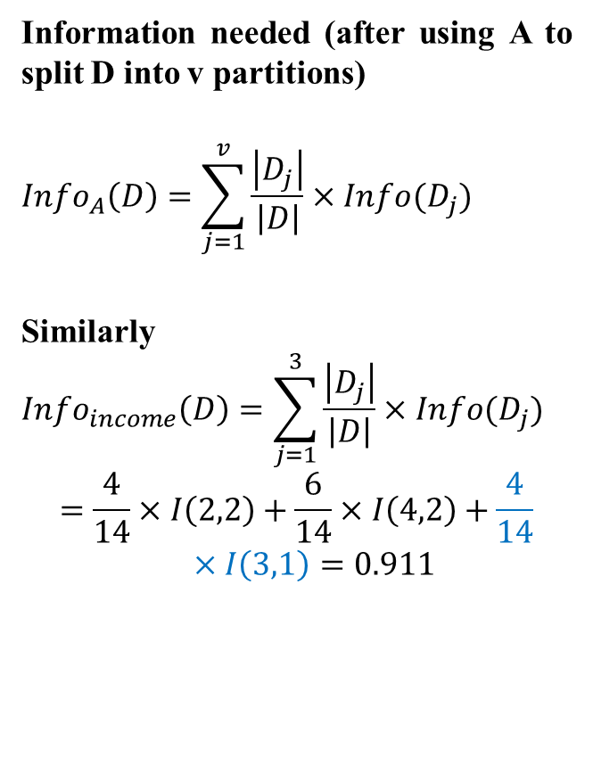
Classification : Decision Tree
Information needed (after using A to split D into v partitions)
$${Info}_{A}\left(D\right)=\sum_{j=1}^{v}{\frac{\left|D_{j}\right|}{\left|D\right|}}×Info(D_{j})$$
Similarly
$${Info}_{income}\left(D\right)=\sum_{j=1}^{3}{\frac{\left|D_{j}\right|}{\left|D\right|}}×Info(D_{j})$$
$$=\frac{4}{14}×I\left(2,2\right)+\frac{6}{14}×I\left(4,2\right)+\frac{4}{14}×I\left(3,1\right)=0.911$$

Slide 27
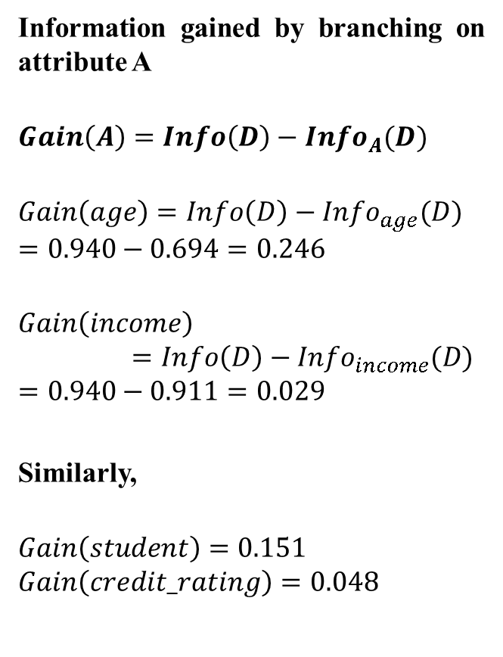
Classification : Decision Tree
Information gained by branching on attribute A
$$Gain\left(A\right)=Info\left(D\right)−{Info}_{A}(D)$$
$$Gain\left(age\right)=Info\left(D\right)−{Info}_{age}(D)$$
$$=0.940−0.694=0.246$$
$$Gain\left(income\right)=Info\left(D\right)−{Info}_{income}(D)$$
$$=0.940−0.911=0.029$$
Similarly,
$$Gain\left(student\right)=0.151$$
$$Gain\left(credit_rating\right)=0.048$$

Slide 28
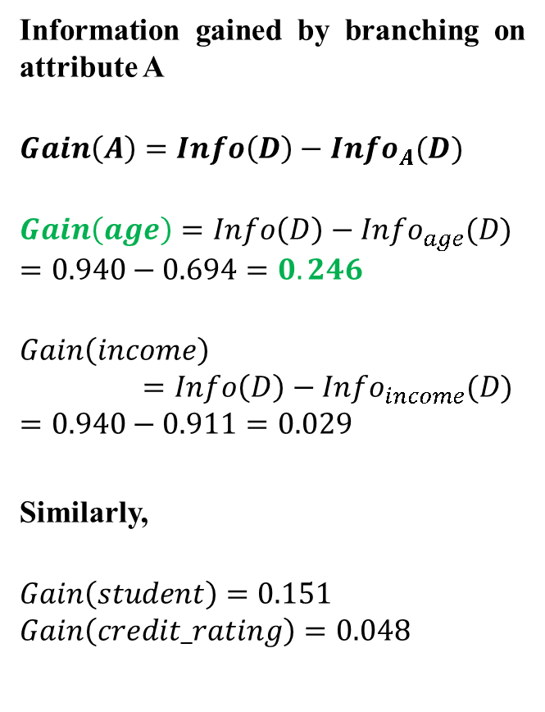
Classification : Decision Tree
Information gained by branching on attribute A
$$Gain\left(A\right)=Info\left(D\right)−{Info}_{A}(D)$$
$$Gain\left(age\right)=Info\left(D\right)−{Info}_{age}(D)$$
$$=0.940−0.694=0.246$$
$$Gain\left(income\right)=Info\left(D\right)−{Info}_{income}(D)$$
$$=0.940−0.911=0.029$$
Similarly,
$$Gain\left(student\right)=0.151$$
$$Gain\left(credit_rating\right)=0.048$$

Slide 29
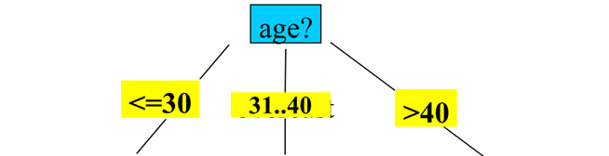
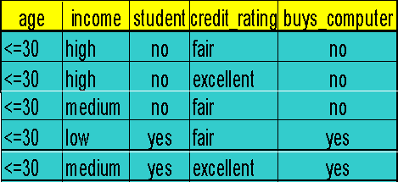
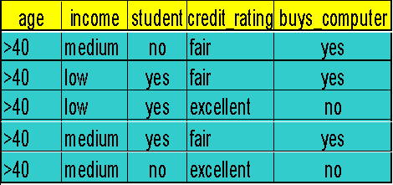
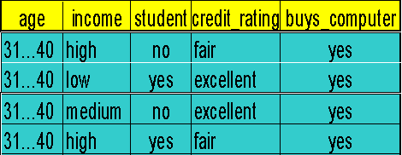
Classification : Decision Tree
Next, repeat the same process with the other nodes with smaller dataset.
So, the first split is on the age attribute

Slide 30
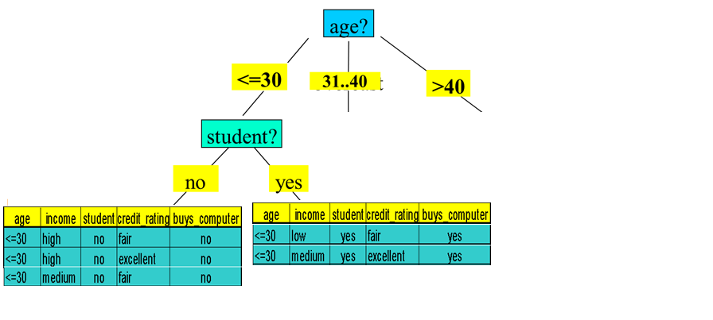
Classification : Decision Tree
Next split is on student at node <=30
All are yes
So, no further split here
All are no
So, no further split here

Slide 31
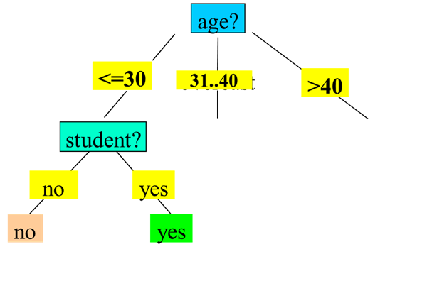
Classification : Decision Tree
No split is required at node 31..40
All are yes
So, no further split here

Slide 32
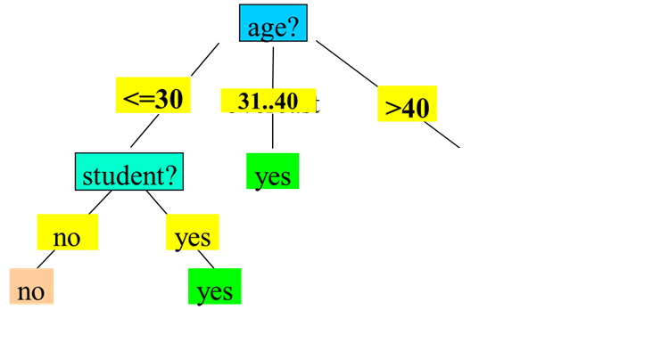
Classification : Decision Tree

Slide 33
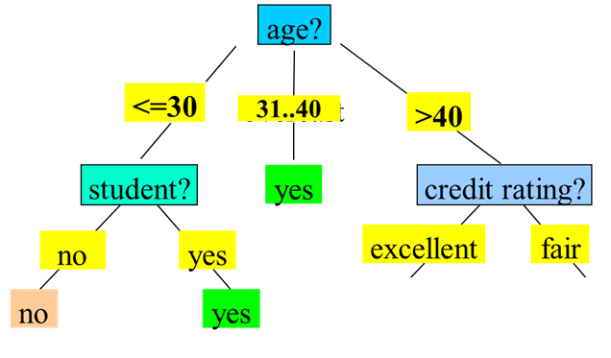

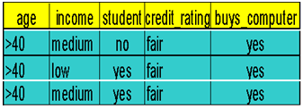
Classification : Decision Tree
Next split is on credit_rating at node >40

Slide 34
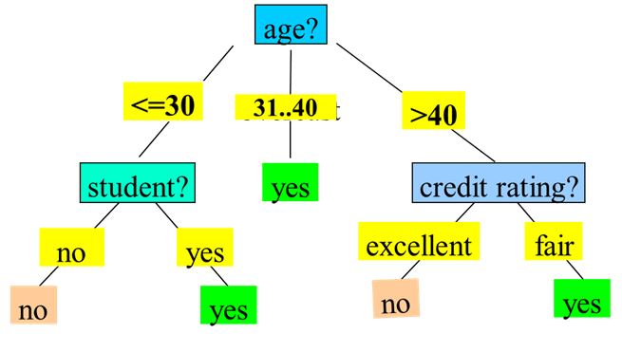
Classification : Decision Tree

Slide 35
Classification : Decision Tree
Classify a new instance
(age: <=30, income: low, student: yes, credit_rating: fair) = buys_computer?

Slide 36
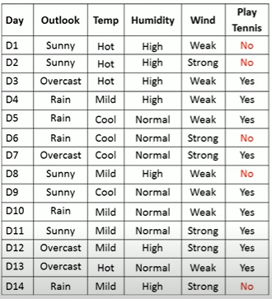
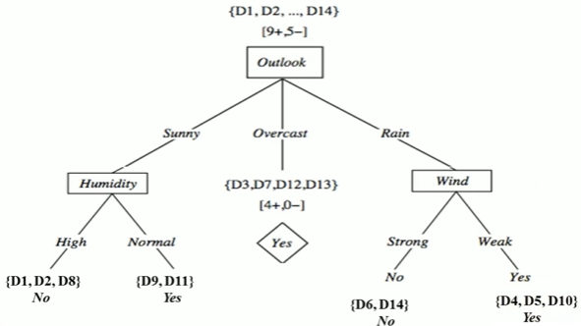
Classification : Decision Tree
Exercise

Slide 37
Classification : Decision Tree
Code
https://colab.research.google.com/drive/1YsHFA55DZ5iQBNq7S11qoS-_WVYtxUYH?usp=sharing

Slide 38
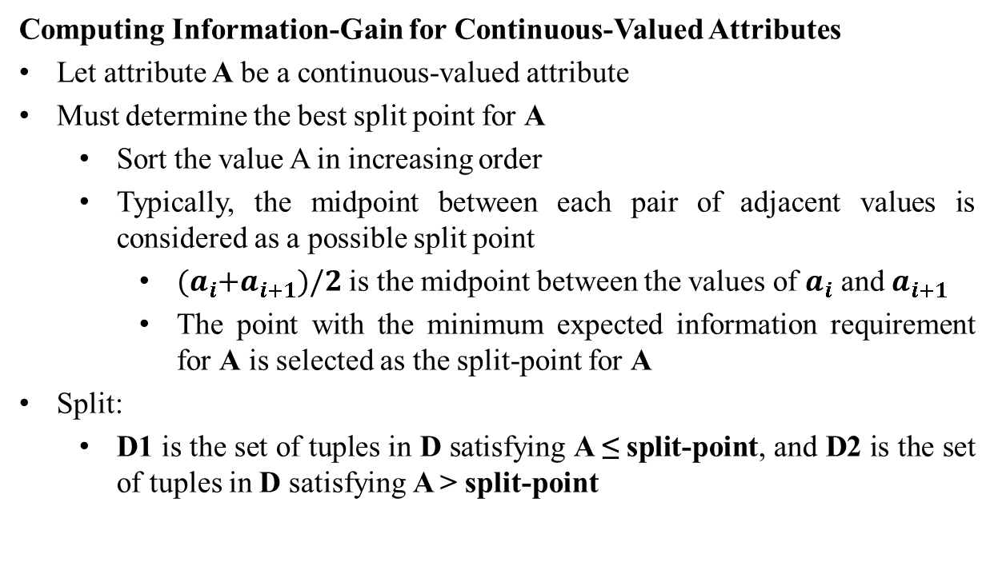
Classification : Decision Tree
Computing Information-Gain for Continuous-Valued Attributes
Let attribute A be a continuous-valued attribute
Must determine the best split point for A
Sort the value A in increasing order
Typically, the midpoint between each pair of adjacent values is considered as a possible split point
${(a}_{i}+a_{i+1})/2$ is the midpoint between the values of $a_{i}$ and $a_{i+1}$
The point with the minimum expected information requirement for A is selected as the split-point for A
Split:
D1 is the set of tuples in D satisfying A ≤ split-point, and D2 is the set of tuples in D satisfying A > split-point

Slide 39
Classification : Decision Tree
Gain Ratio for Attribute Selection (C4.5)
Information gain measure is biased towards attributes with many values
C4.5 (a successor of ID3) uses gain ratio to overcome the problem (normalization to information gain)
GainRatio(A) = Gain(A)/SplitInfo(A)
gain_ratio(income) = 0.029/1.557 = 0.019

Slide 40
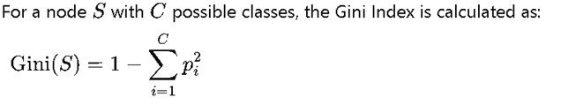
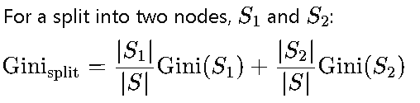
Classification : Decision Tree
Gini Index (CART-Classification and Regression Trees)
Information Gain and Gain Ratio can sometimes exhibit a bias toward features with many unique values. For example, if a feature has many unique categories, Information Gain might prefer it because it creates more distinct subsets.
To address this, Gain Ratio (an adaptation of Information Gain) is used in algorithms like C4.5 to counter this bias, but this additional step adds complexity.
Gini Index, on the other hand, is less sensitive to the number of categories in a feature, reducing the need for an additional adjustment like Gain Ratio.

Slide 41
Classification : Decision Tree
Overfitting in Decision Trees
Overfitting happens when a Decision Tree model becomes too complex, fitting too closely to the noise and specific details of the training data, resulting in poor generalization to new data.
Signs of Overfitting: A decision tree that overfits will often have a high accuracy on the training set but performs poorly on the test set.
Causes of Overfitting:
Allowing the tree to grow too deep, with many nodes and branches.
Having very specific branches (splits) that capture the peculiarities of the training data rather than general patterns.
Consequences: Overfitting leads to a lack of model generalization, where the model captures random fluctuations instead of meaningful trends.

Slide 42
Classification : Decision Tree
Pre-Pruning (Early Stopping):
This approach stops the tree from growing once it meets certain conditions, such as reaching a maximum depth, minimum number of samples per leaf, or minimum information gain threshold. This prevents the tree from developing complex branches that might lead to
Post-Pruning (Cost Complexity Pruning):
This technique first grows the tree to its full depth, then prunes back branches that provide minimal value. Post-pruning can be based on measures like cross-validation to determine the optimal structure that minimizes errors on new data.

Slide 43
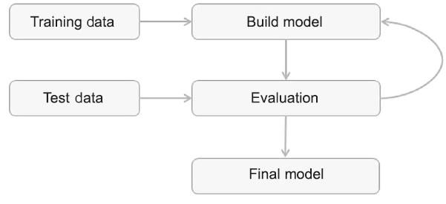
Model Evaluation
Model evaluation metrics are used to measure the quality and performance of your machine learning models. The choice of metric depends on the type of problem you're solving, primarily classification or regression.

Slide 44
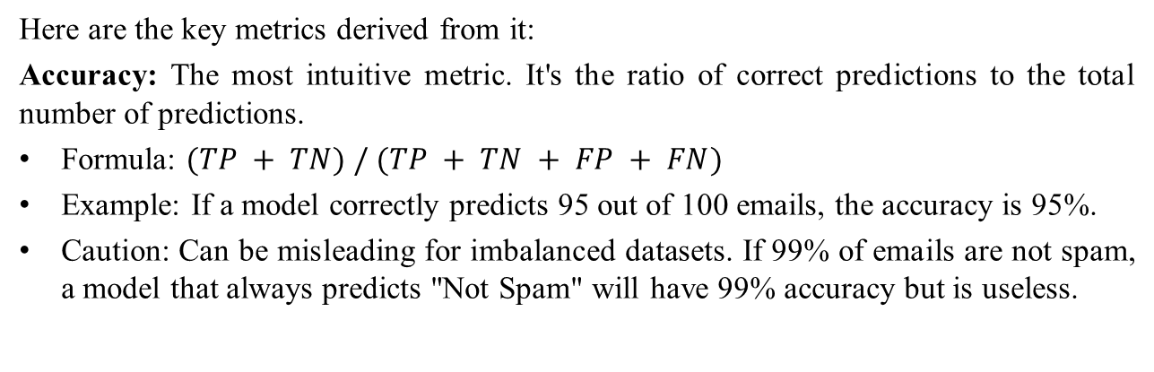
Model Evaluation: Classification Metrics
These are used when the goal is to predict a category or class (e.g., "Spam" vs. "Not Spam," "Cat" vs. "Dog"). They are often calculated from a Confusion Matrix. A Confusion Matrix is a table that summarizes the performance of a classification model:
 | Predicted: Negative | Predicted: Positive
Actual: Negative | True Negative (TN) | False Positive (FP)
Actual: Positive | False Negative (FN) | True Positive (TP)
Here are the key metrics derived from it:
Accuracy: The most intuitive metric. It's the ratio of correct predictions to the total number of predictions.
Formula: $(TP + TN) / (TP + TN + FP + FN)$
Example: If a model correctly predicts 95 out of 100 emails, the accuracy is 95%.
Caution: Can be misleading for imbalanced datasets. If 99% of emails are not spam, a model that always predicts "Not Spam" will have 99% accuracy but is useless.

Slide 45
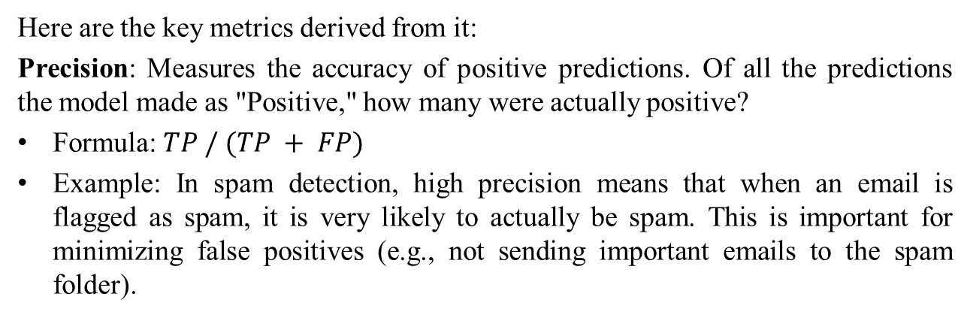
Model Evaluation: Classification Metrics
These are used when the goal is to predict a category or class (e.g., "Spam" vs. "Not Spam," "Cat" vs. "Dog"). They are often calculated from a Confusion Matrix. A Confusion Matrix is a table that summarizes the performance of a classification model:
 | Predicted: Negative | Predicted: Positive
Actual: Negative | True Negative (TN) | False Positive (FP)
Actual: Positive | False Negative (FN) | True Positive (TP)
Here are the key metrics derived from it:
Precision: Measures the accuracy of positive predictions. Of all the predictions the model made as "Positive," how many were actually positive?
Formula: $TP / (TP + FP)$
Example: In spam detection, high precision means that when an email is flagged as spam, it is very likely to actually be spam. This is important for minimizing false positives (e.g., not sending important emails to the spam folder).

Slide 46
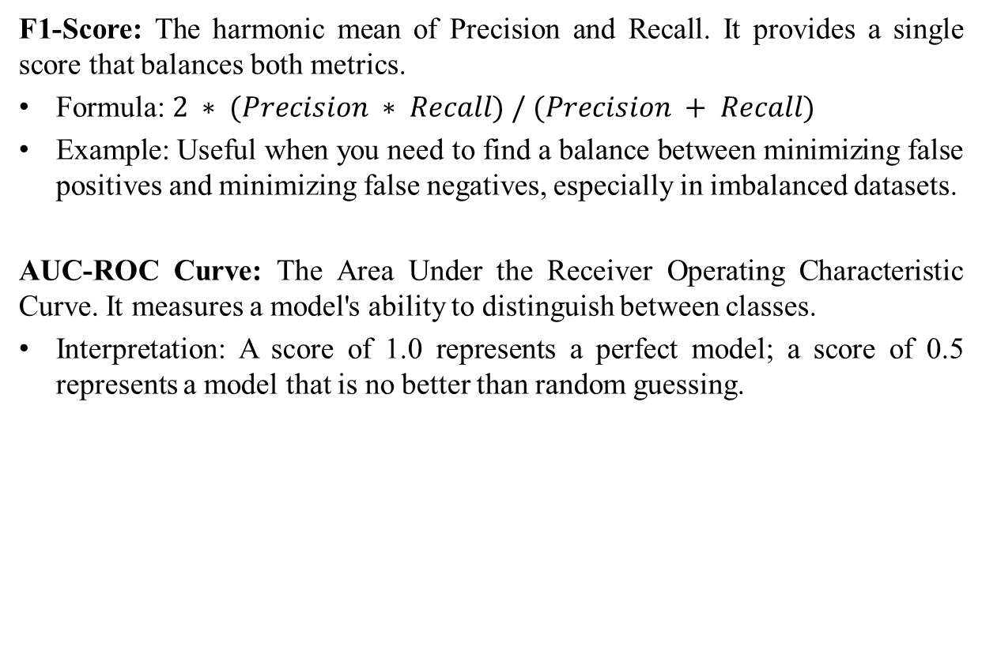
Model Evaluation: Classification Metrics
F1-Score: The harmonic mean of Precision and Recall. It provides a single score that balances both metrics.
Formula: $2 ∗ (Precision ∗ Recall) / (Precision + Recall)$
Example: Useful when you need to find a balance between minimizing false positives and minimizing false negatives, especially in imbalanced datasets.
AUC-ROC Curve: The Area Under the Receiver Operating Characteristic Curve. It measures a model's ability to distinguish between classes.
Interpretation: A score of 1.0 represents a perfect model; a score of 0.5 represents a model that is no better than random guessing.

Slide 47
Model Evaluation: Regression Metrics
These are used when the goal is to predict a continuous numerical value (e.g., a house price, a person's age).
Mean Absolute Error (MAE): The average of the absolute differences between the predicted and actual values.
Example: If you are predicting house prices and your MAE is $10,000, it means that, on average, your model's prediction is off by $10,000. It's easy to interpret because it's in the same units as the output.
Mean Squared Error (MSE): The average of the squared differences between the predicted and actual values.
Example: Similar to MAE but punishes larger errors more heavily because it squares the difference. If your model predicts a price that is off by $50,000, the squared error is huge, which significantly raises the MSE.

Slide 48
Model Evaluation: Regression Metrics
Root Mean Squared Error (RMSE): The square root of the MSE.
Example: This is often preferred over MSE because taking the square root brings the metric back into the same units as the original target variable (e.g., dollars for house prices), making it more interpretable. It still penalizes large errors more than MAE.
R-Squared (R²): Also known as the coefficient of determination. It represents the proportion of the variance in the dependent variable that is predictable from the independent variables.
Interpretation: It ranges from 0 to 1. An R² of 0.82 means that 82% of the variance in the output variable can be explained by the model's inputs. A higher R² generally indicates a better fit.

